Slide 1
Rocket Stability
Building a Test Rocket
LabRat Scientific
© 2018

Slide 2
Materials and Supplies:
Model Rocket Kit
Balsawood sheet
Paper Towel Tube
Sheet of Paper
Aluminum Foil
Utility/Hobby Knife
Masking Tape
Pencil / Marker
White Glue
5-minute Epoxy

Slide 3
It is suggested that a model rocket kit be purchased for this project. You should find a rocket that has a diameter on the order of 5 cm (~2 in.) and a length around 50 cm (~20 in.). The rocket kit will include tubes, nose cone, and balsawood for fins.
The dimensions of the tubes are not critical, its just easier to work with a larger model rocket.

Slide 4
Items to be Built
Rocket Body
Nose Cone
Maintain a constant fin area for each fin set.
Movable String Collar
Fin Sets Mounted to Fin Collars

Slide 5
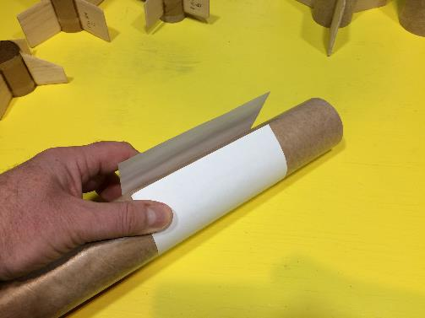
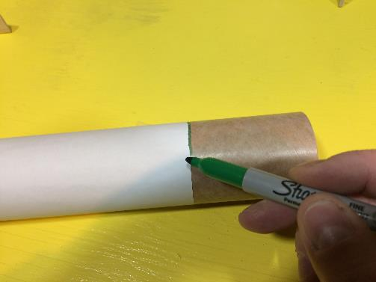
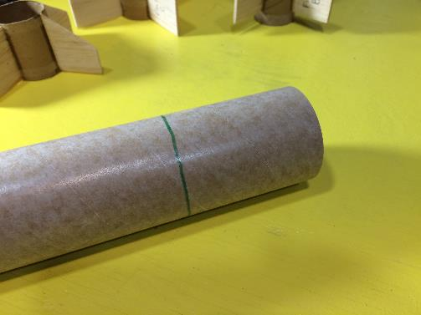
Marking Fin Mounting Collars
Use a strip of paper to serve as a marking guide. Align the edges of the paper and tape. If the edges of the paper are aligned prior to marking, the faces of the cut tube will be parallel.

Slide 6
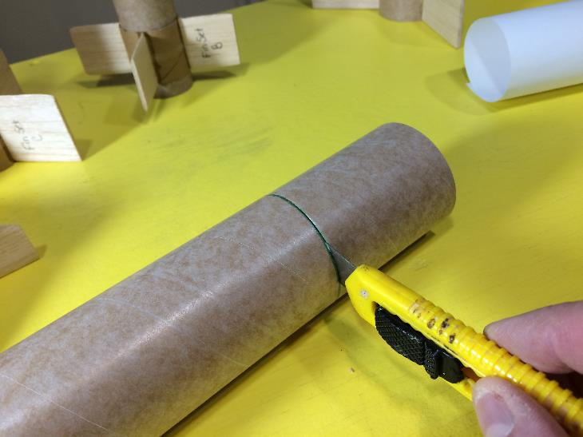
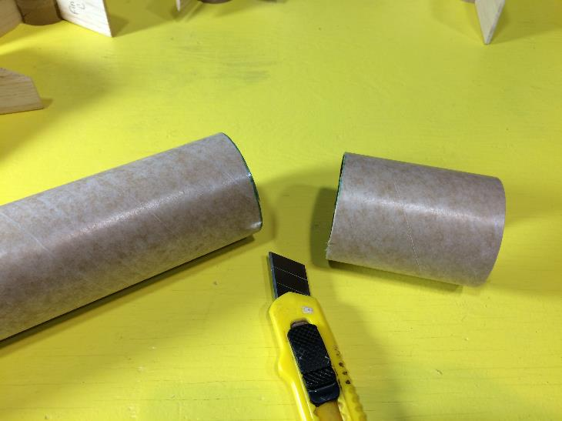
Cutting Fin Mounting Collars
Use a utility knife to cut the tube. Make sure the blade is sharp to ensure a clean cut.

Slide 7
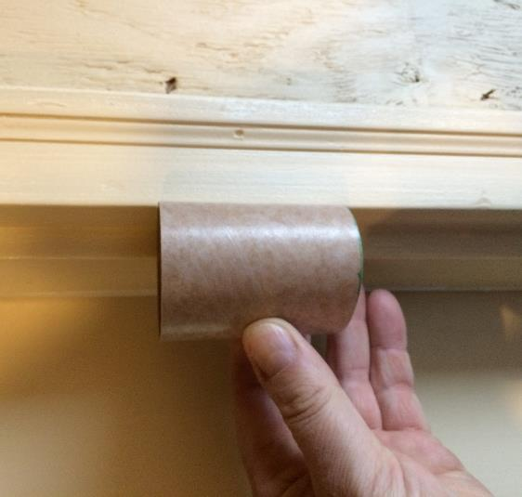
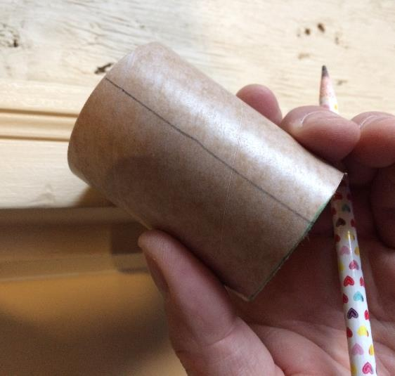
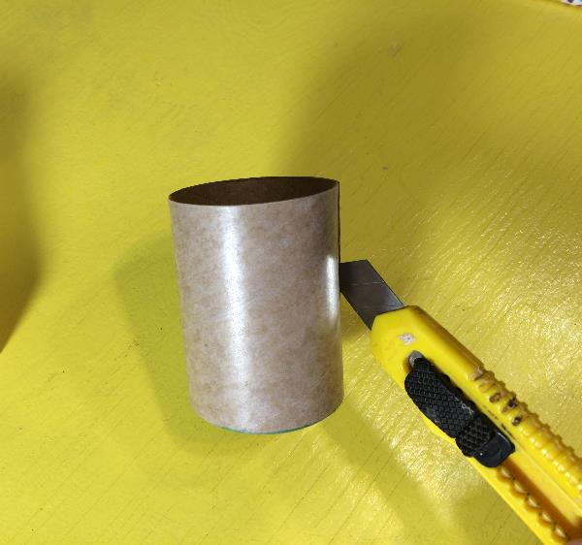
Longitudinal Cut Line
Place the collar tubes in the notch in a door frame and mark a longitudinal cut line on the tubes. This method ensures the cut line is parallel to the tube’s sides (or you can free hand it with scissors….)

Slide 8
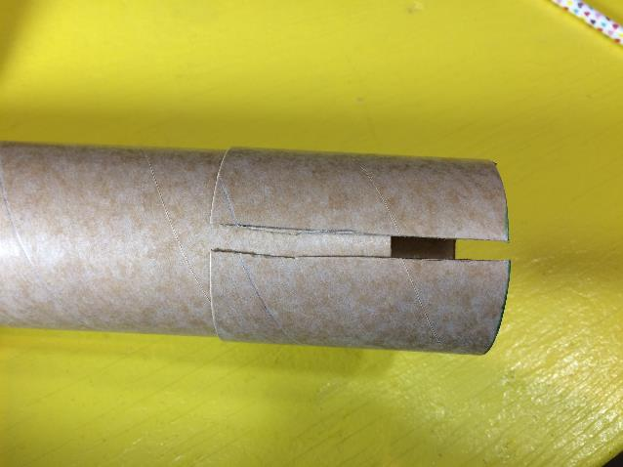
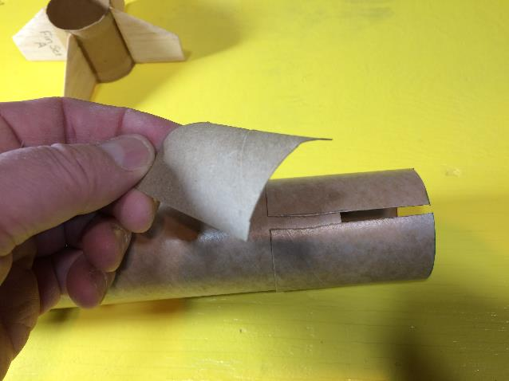
Making the Collar Patch
This view shows the cut collar. Cut out a collar patch out of a section of old paper towel tube.

Slide 9
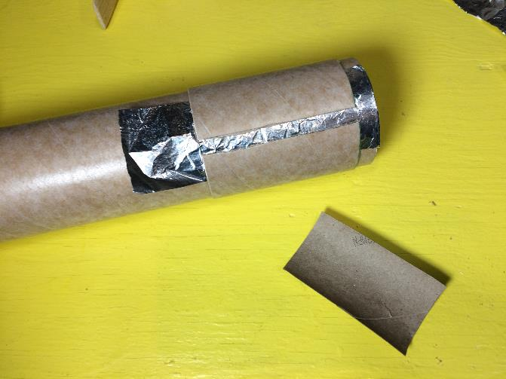
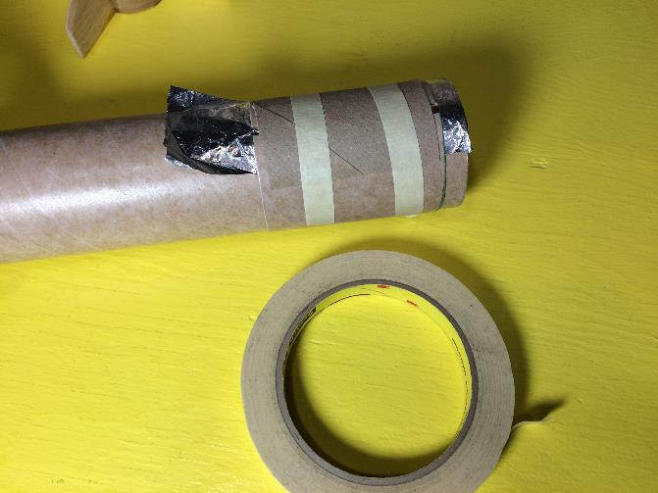
Gluing the Collar Patch
Use the rocket body tube to properly size the collar circumference. Place a piece of aluminum foil under the gap in the collar. This will prevent the collar from being accidentally glued to the body tube. Smear white glue on the back side of the collar patch and place on the collar. Secure with masking tape, making sure the collar fits snuggly on the tube

Slide 10
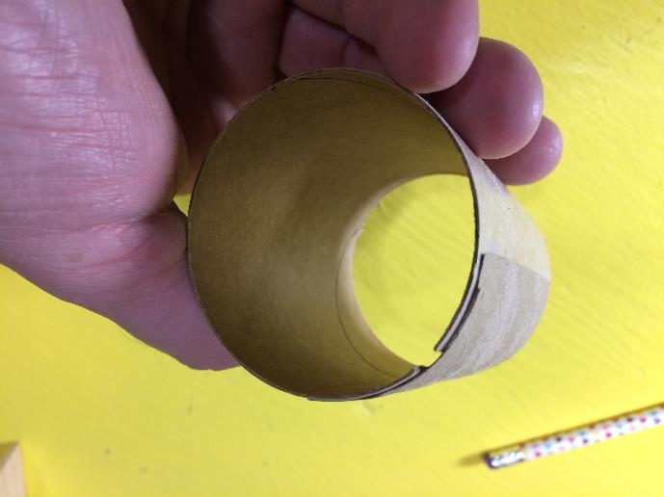
Completed Fin Collar

Slide 11
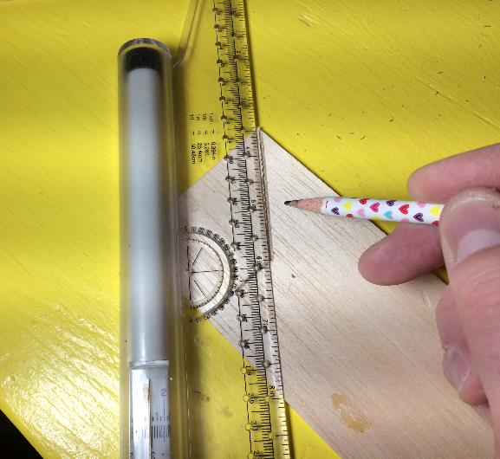
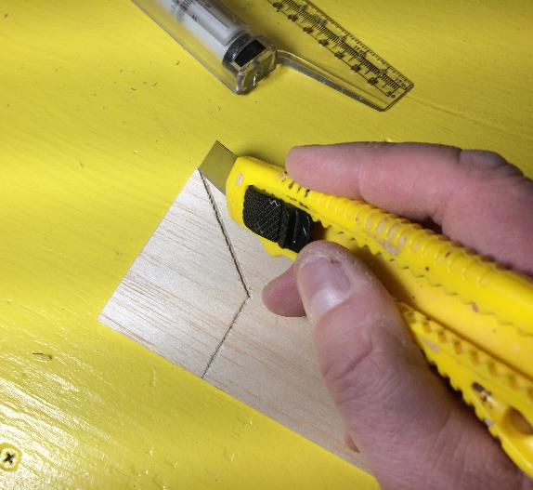
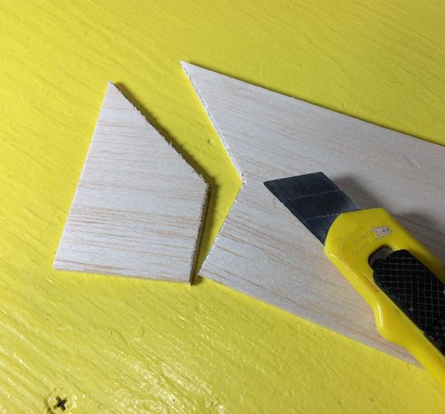
Cutting out Fins
Design your fins, then draw them on the balsa wood sheet. Carefully cut out the fins with a sharp utility knife.

Slide 12
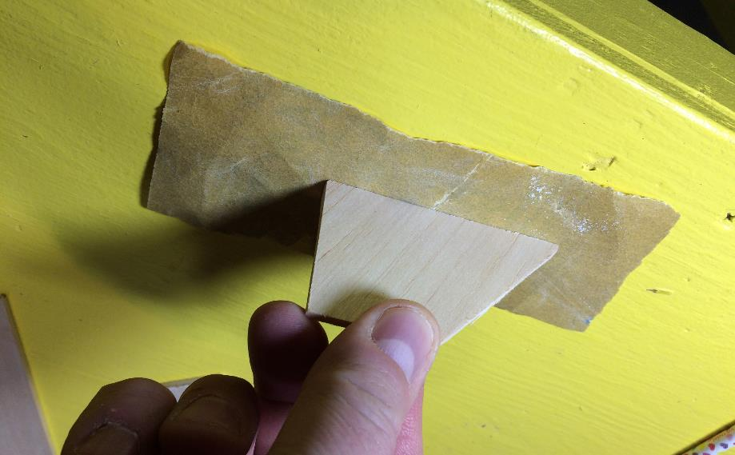
Fin Sanding
90 deg
Place a piece of sandpaper on the table top. Smooth each of the edges of the fins. Keep the fin perpendicular to the sand paper.

Slide 13
Making a Paper Fin Alignment Guide
Cut a 2” (approx.) wide strip of paper. Make it long enough so it can be wrapped around the body tube. Leave some overlap (cross hatched area)
Fold the paper strip in half, leaving the overlap section sticking out… Make marks on the fold line.
Fold the paper strip in half again, leaving the overlap section sticking out as before… Make marks on the fold line.
When you unfold the paper strip, you should end up with evenly spaced reference marks.

Slide 14
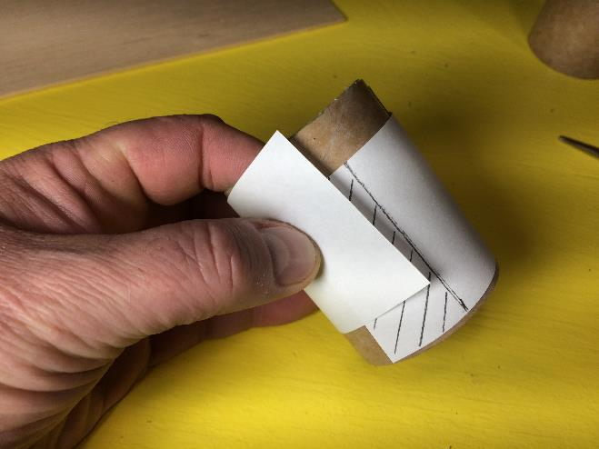
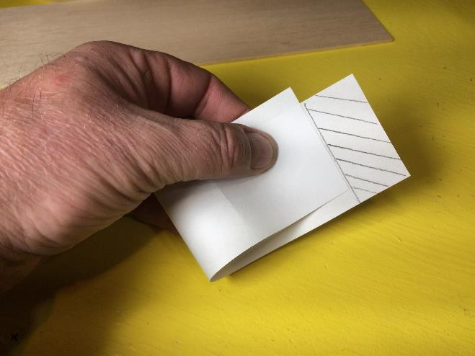
Making a Paper Fin Alignment Guide
Wrap the paper strip around the fin collar. The cross-hatched area denotes the overlap. Fold the strip in half up to the edge of the overlap area.

Slide 15
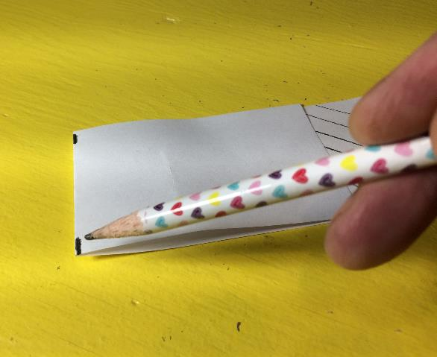
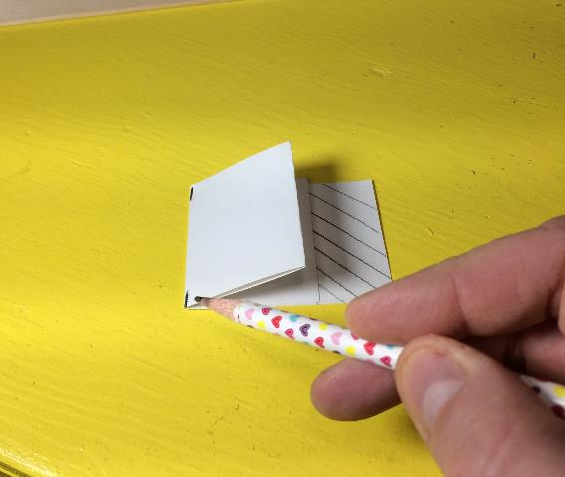
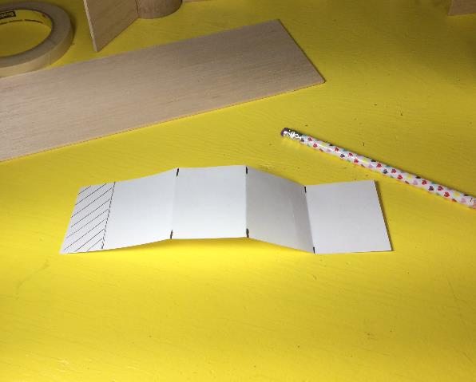
Making a Paper Fin Alignment Guide
Fold the strip of paper in half, then mark the fold line. Fold the paper in half a second time and mark the fold lines. Once this is done, the strip will be divided into 4 equal sections.

Slide 16
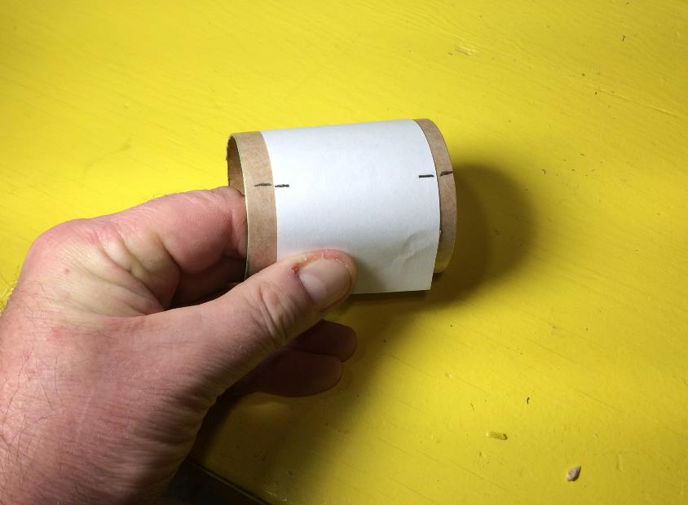
Making a Paper Fin Alignment Guide
Wrap the completed fin guide around the fin collar and transfer marks to the tube.

Slide 17
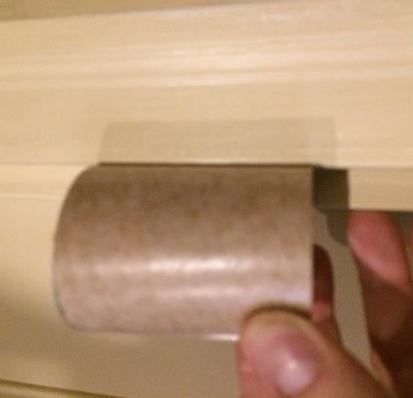
Mark the fin alignment lines on the Fin Collar
Fin alignment line (4 total)
Use a ruler to connect the reference lines, or use the door frame notch technique. The fins will be glued along these lines. If done properly, the fins will be equally spaced and aligned with the rocket body tube

Slide 18
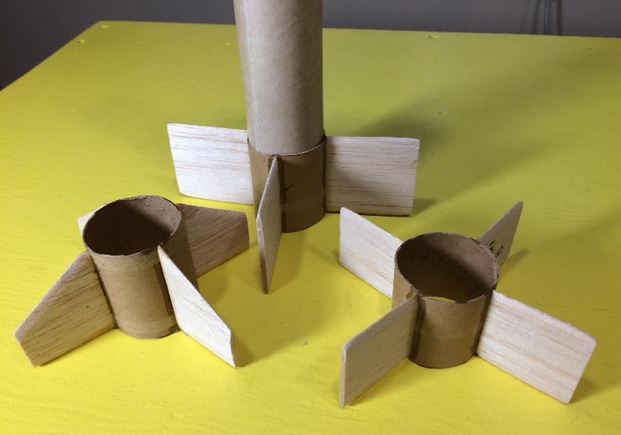
Securing Fins to the Fin Collars
Use 5-minute epoxy to secure the fins to the fin collars. Use of the epoxy greatly speeds up the fin gluing process (white glue takes a long time to dry…).

Slide 19
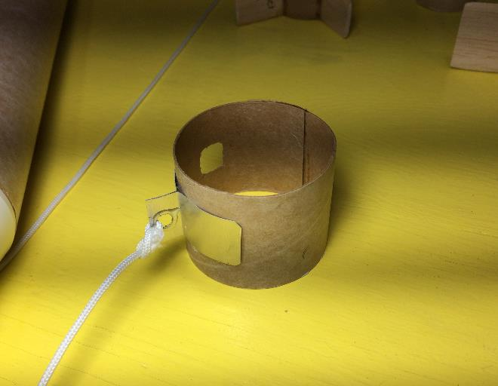
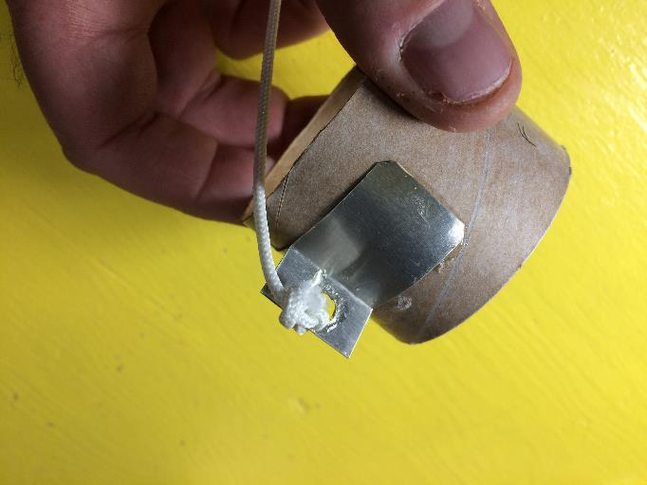
String Collar
The same collar fabrication techniques can be used to fabricate a movable string collar. A string attachment loop can be made out of a paperclip, poster board or thin metal flashing.

Slide 20
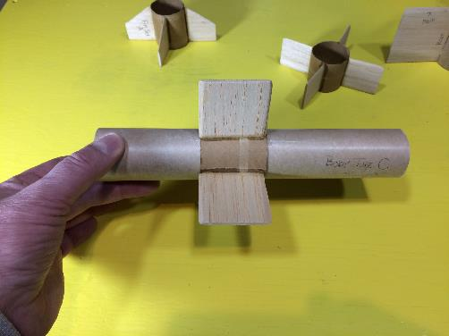
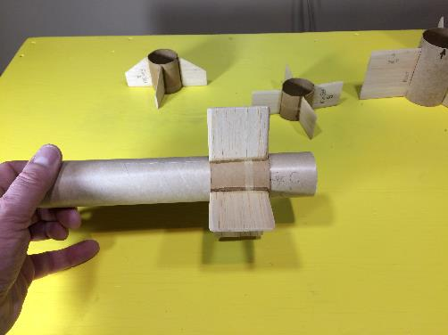
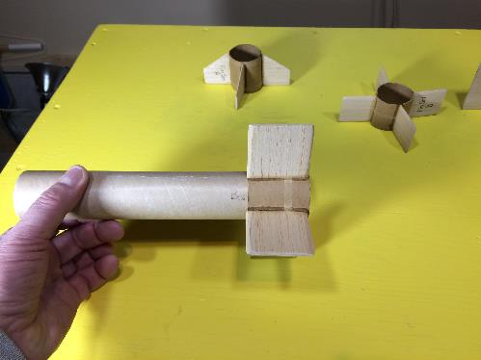
Fin Set on Body Tube
These images show how the fin sets can be positioned along the body tube.

Slide 21
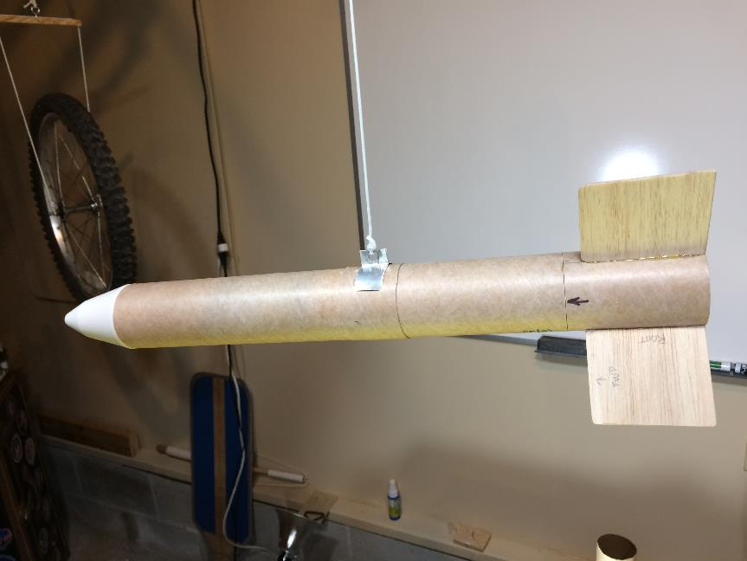
The completed test rocket with large square fins.

