Slide 1
Lecture Slides
Chapter 7
Shafts and Shaft Components
© 2015 by McGraw-Hill Education. This is proprietary material solely for authorized instructor use. Not authorized for sale or distribution in any manner. This document may not be copied, scanned, duplicated, forwarded, distributed, or posted on a website, in whole or part.

Slide 2
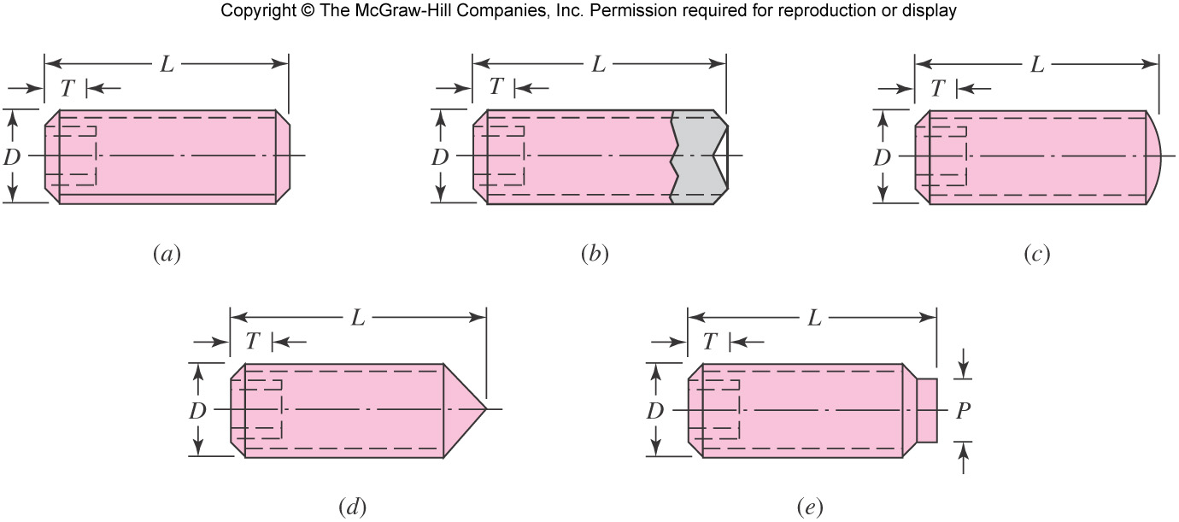
Setscrews
Setscrews resist axial and rotational motion
They apply a compressive force to create friction
The tip of the set screw may also provide a slight penetration
Various tips are available
Fig. 7–15

Slide 3
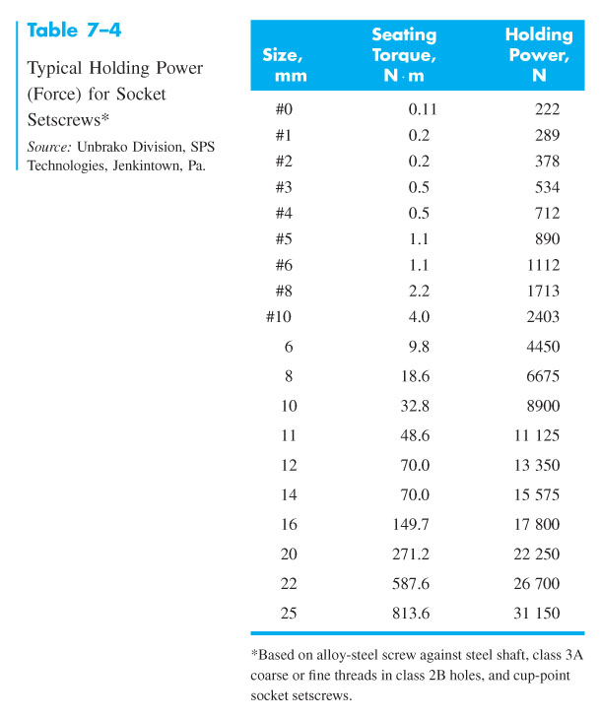
Setscrews
Resistance to axial motion of collar or hub relative to shaft is called holding power
Typical values listed in Table 7–4 apply to axial and torsional resistance
Typical factors of safety are 1.5 to 2.0 for static, and 4 to 8 for dynamic loads
Length should be about half the shaft diameter

Slide 4
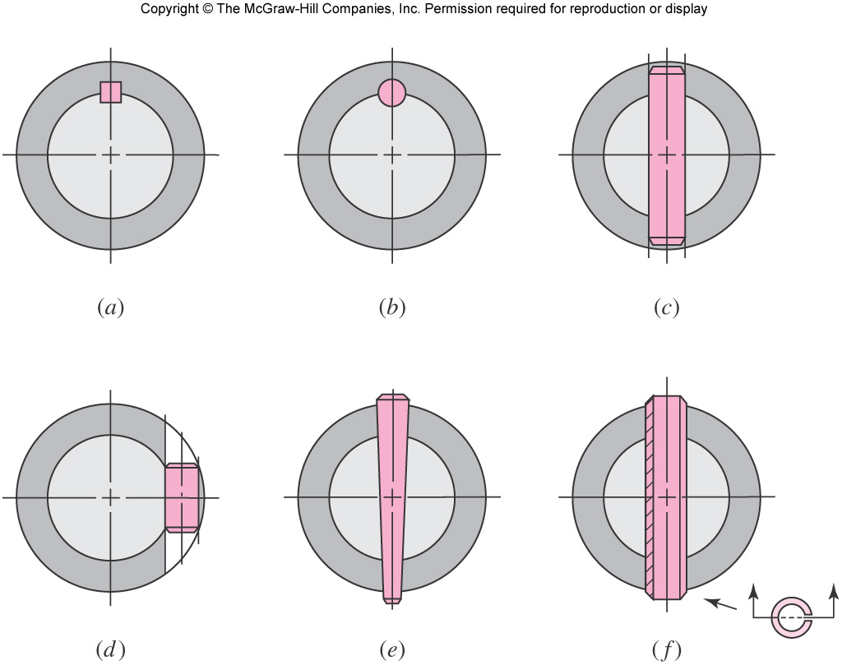
Keys and Pins
Used to secure rotating elements and to transmit torque
Fig. 7–16

Slide 5
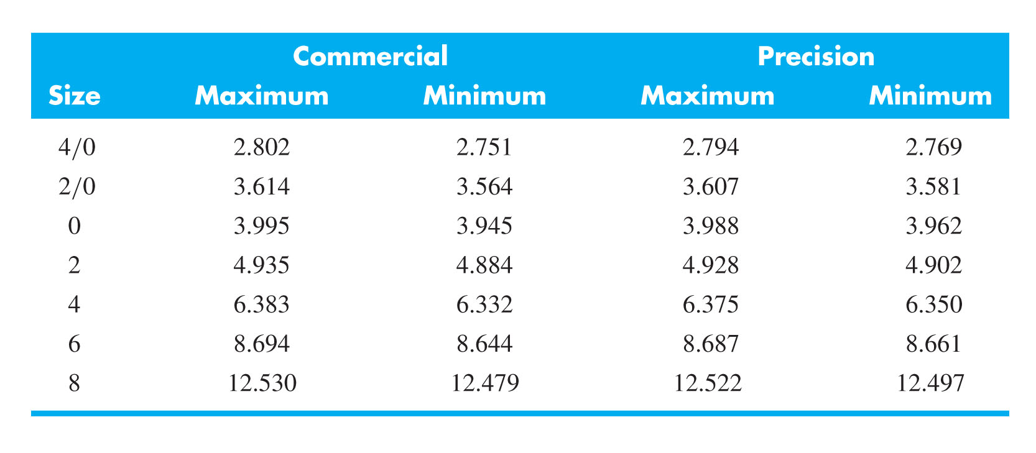
Tapered Pins
Taper pins are sized by diameter at large end
Small end diameter is
Table 7–5 shows some standard sizes in inches
Table 7–5

Slide 6
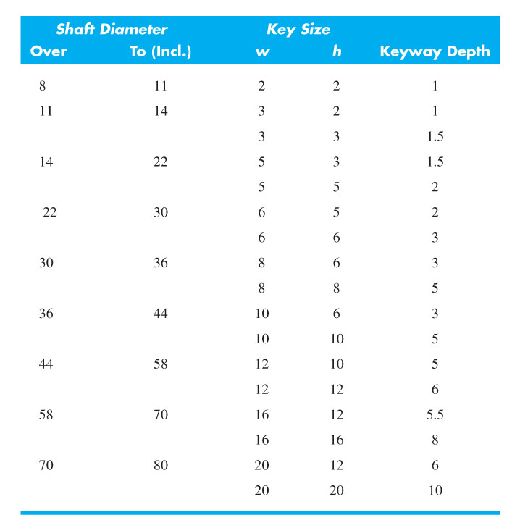
Keys
Keys come in standard square and rectangular sizes
Shaft diameter determines key size
Table 7–6

Slide 7
Keys
Failure of keys is by either direct shear or bearing stress
Key length is designed to provide desired factor of safety
Factor of safety should not be excessive, so the inexpensive key is the weak link
Key length is limited to hub length
Key length should not exceed 1.5 times shaft diameter to avoid problems from twisting
Multiple keys may be used to carry greater torque, typically oriented 90º from one another
Stock key material is typically low carbon cold-rolled steel, with dimensions slightly under the nominal dimensions to easily fit end-milled keyway
A setscrew is sometimes used with a key for axial positioning, and to minimize rotational backlash

Slide 8
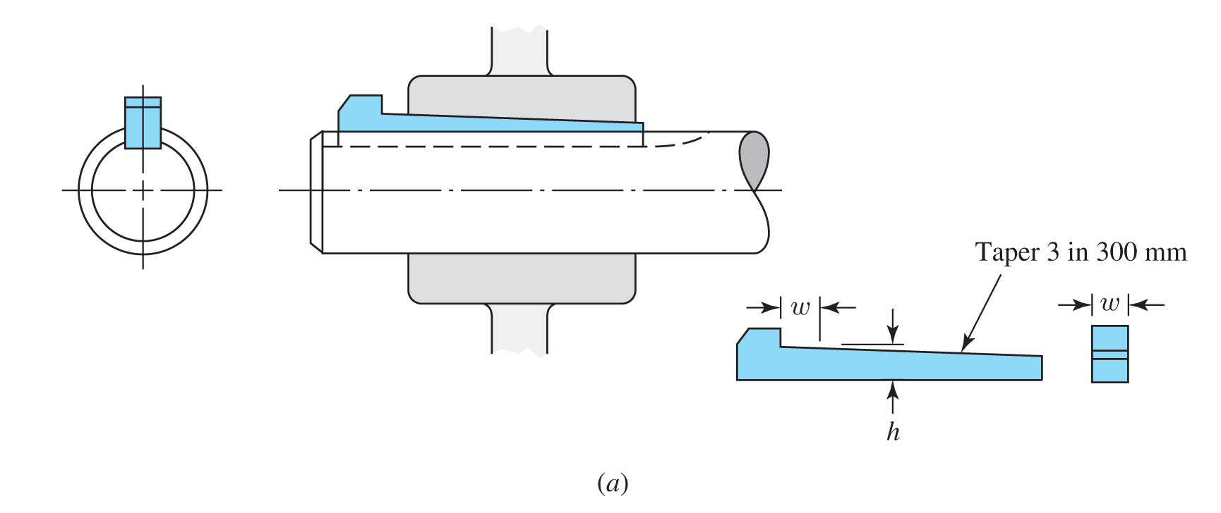
Gib-head Key
Gib-head key is tapered so that when firmly driven it prevents axial motion
Head makes removal easy
Projection of head may be hazardous
Fig. 7–17

Slide 9
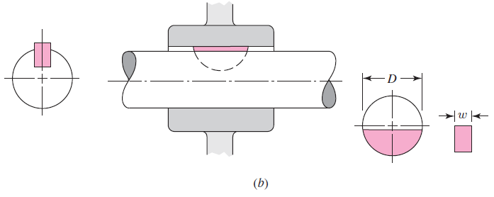
Woodruff Key
Woodruff keys have deeper penetration
Useful for smaller shafts to prevent key from rolling
When used near a shoulder, the keyway stress concentration interferes less with shoulder than square keyway
Fig. 7–17

Slide 10
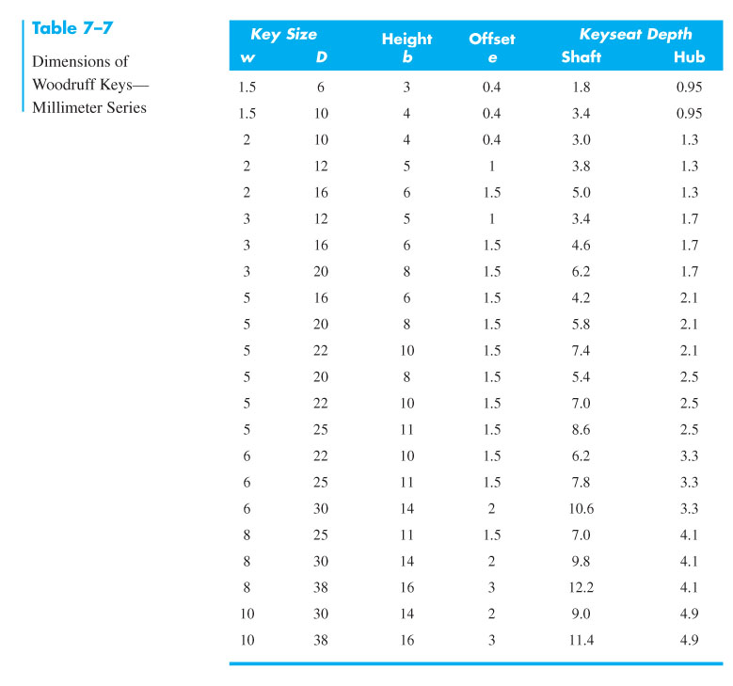
Woodruff Key

Slide 11
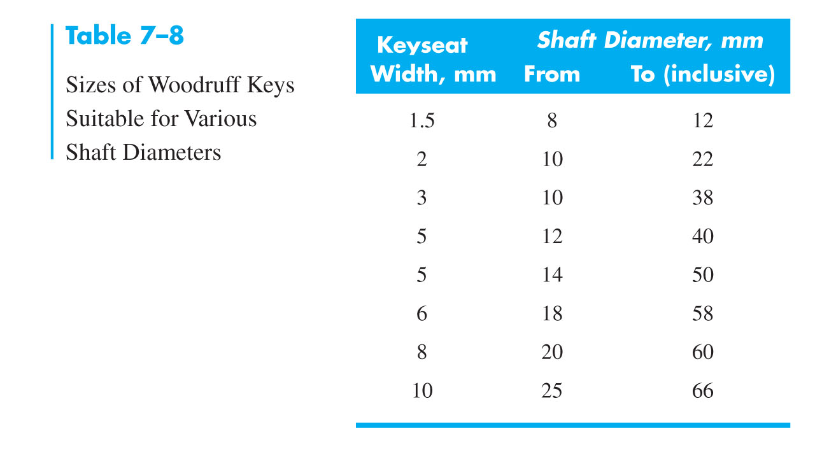
Woodruff Key

Slide 12
Stress Concentration Factors for Keys
For keyseats cut by standard end-mill cutters, with a ratio of r/d = 0.02, Peterson’s charts give
K_{t} = 2.14 for bending
K_{t} = 2.62 for torsion without the key in place
K_{t} = 3.0 for torsion with the key in place
Keeping the end of the keyseat at least a distance of d/10 from the shoulder fillet will prevent the two stress concentrations from combining.

Slide 13
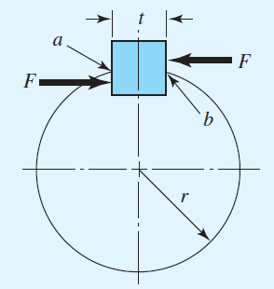
Example 7–6
Fig. 7–19

Slide 14
Example 7–6 (continued)

Slide 15
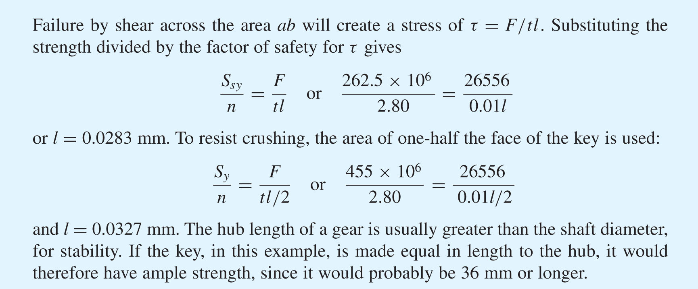
Example 7–6 (continued)
32,7

Slide 16
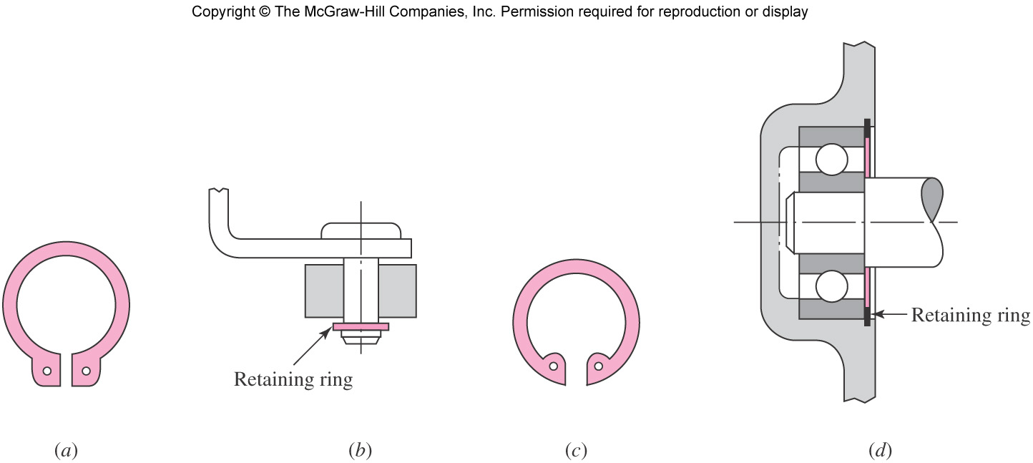
Retaining Rings
Retaining rings are often used instead of a shoulder to provide axial positioning
Fig. 7–18

Slide 17
Retaining Rings
Retaining ring must seat well in bottom of groove to support axial loads against the sides of the groove.
This requires sharp radius in bottom of groove.
Stress concentrations for flat-bottomed grooves are available in Table A–15–16 and A–15–17.
Typical stress concentration factors are high, around 5 for bending and axial, and 3 for torsion

Slide 18
Stress in Interference Fits
Interference fit generates pressure at interface
Need to ensure stresses are acceptable
Treat shaft as cylinder with uniform external pressure
Treat hub as hollow cylinder with uniform internal pressure
These situations were developed in Ch. 3 and will be adapted here

Slide 19
Stress in Interference Fits
The pressure at the interface, from Eq. (3–56) converted into terms of diameters,
If both members are of the same material,
δ is diametral interference
Taking into account the tolerances,

Slide 20
Stress in Interference Fits
From Eqs. (3–58) and (3–59), with radii converted to diameters, the tangential stresses at the interface are
The radial stresses at the interface are simply
The tangential and radial stresses are orthogonal and can be combined using a failure theory

Slide 21
Torque Transmission from Interference Fit
Estimate the torque that can be transmitted through interference fit by friction analysis at interface
Use the minimum interference to determine the minimum pressure to find the maximum torque that the joint should be expected to transmit.

