Slide 1
TMEC005 – TERMODINÂMICA
Capitulo-12-Misturas de gases ideais e psicrometria
Aula Nr 11
Prof. José Viriato Coelho Vargas

Slide 4
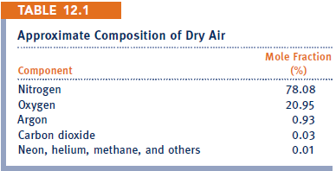

Slide 5
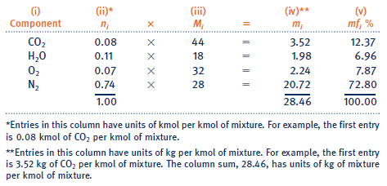

Slide 6
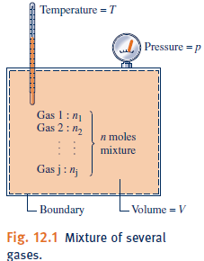
Since ideal gas molecules exert negligible forces on one another, the DALTON model assumes each gas is at the same T and V of the mixture. Then, each gas i has a partial pressure

Slide 7
Historically, the DALTON model has been more utilized than the Amagat model

Slide 8
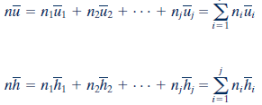

Slide 9
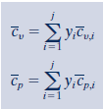

Slide 11
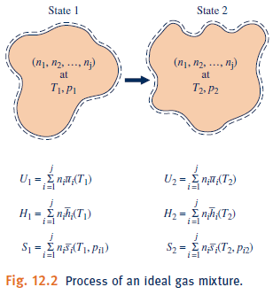
Only the evaluation of properties of the mixture changes in comparison to the single substances analyses

Slide 12
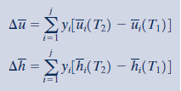

Slide 13
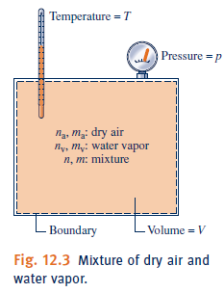
The study of systems involving dry air and water → psychrometrics (air is treated as a pure component)

Slide 14
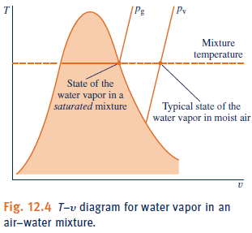
The amount of water vapor in moist air varies from zero in dry air to a maximum, depending on p and T When the mixture is saturated.

Slide 16
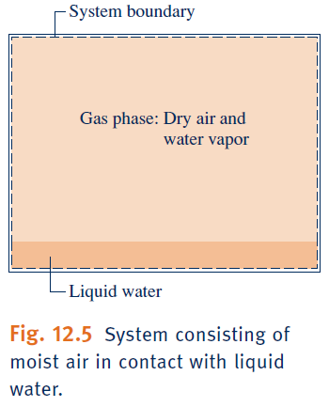

Slide 17
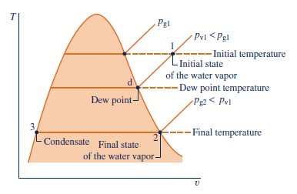
For low vapor pressures

Slide 20
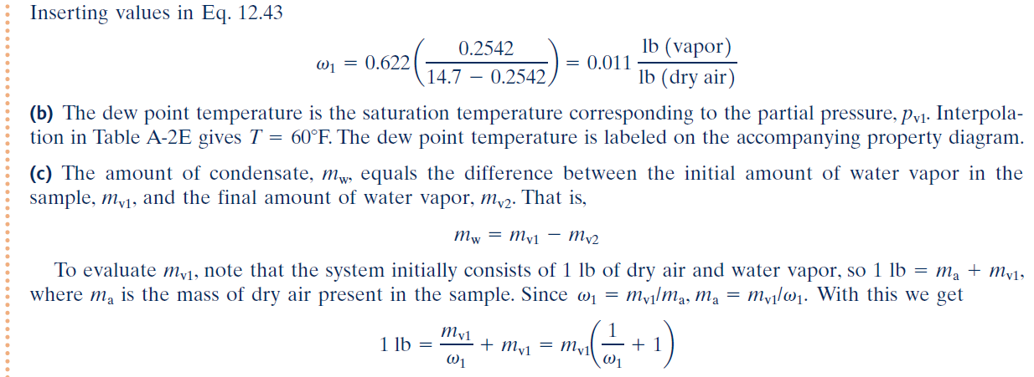

Slide 25
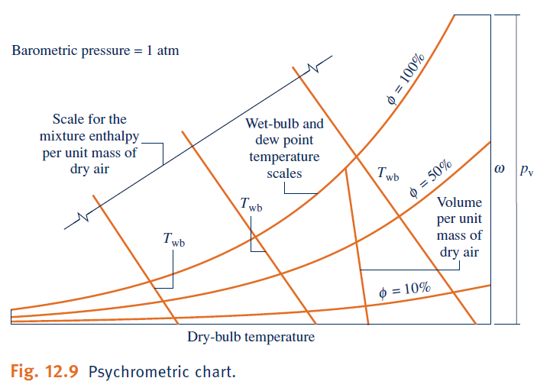

Slide 26
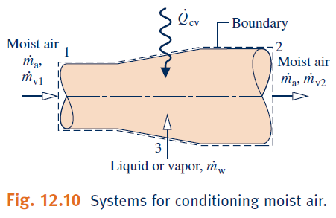

Slide 28
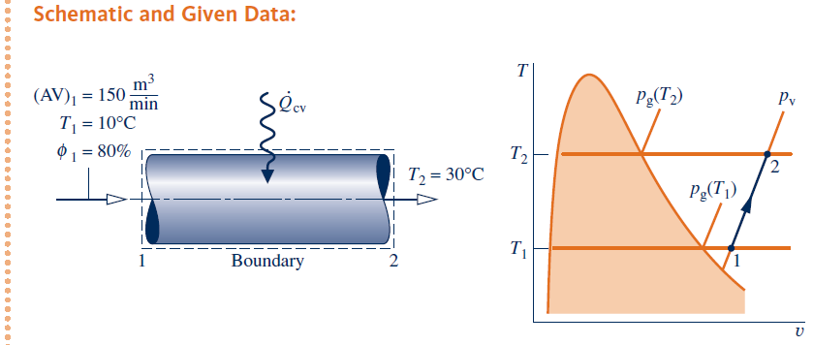

Slide 33
