Slide 1

Department of Mechanical and Aerospace Engineering - MAE
EML3018C Mechanical Systems II
Stresses in Spur Gears
(AGMA Standards)
Dr. José Viriato Coelho Vargas
April 14, 2026

Slide 2
Topics
American Gear Manufacturers Association (AGMA)
Practical applications of spur gears
Gear tooth nomenclature review
Stresses in spur gears
Bending Stresses – Ex. 12-5: Bending Stress Analysis (Norton, 2020)
Surface Stresses – Ex. 12-6: Surface Stress Analysis (Norton, 2020)
Gear materials – Ex. 12-7: Material Selection and Safety Factors (Norton, 2020)
Summary of the design strategy and more complex analyses overview

Slide 3
1. AGMA
Definition: The American Gear Manufacturers Association (AGMA) is the primary body that supports research in gear design, materials, and manufacturing.
Role: AGMA publishes the standards for the design, manufacture, and assembly of gears, ensuring they are highly standardized regarding tooth shape and size.
Standardization: Because of AGMA, designers can use simplified approaches (like the one presented here) or more complex methods found in specialized AGMA publications to ensure gear reliability.

Slide 4
2. Practical Applications of Spur Gears
Spur gears are used to transmit torque and angular velocity between parallel shafts. Examples:
Automobile Transmissions: A common application where gearsets exchange torque for velocity to drive heavy loads.
Rack-and-Pinion Steering: Converts the rotary motion of the steering wheel into the linear translation of a rack to steer the car's wheels.
Aircraft Servomechanisms: Used in critical control surfaces.

Slide 5
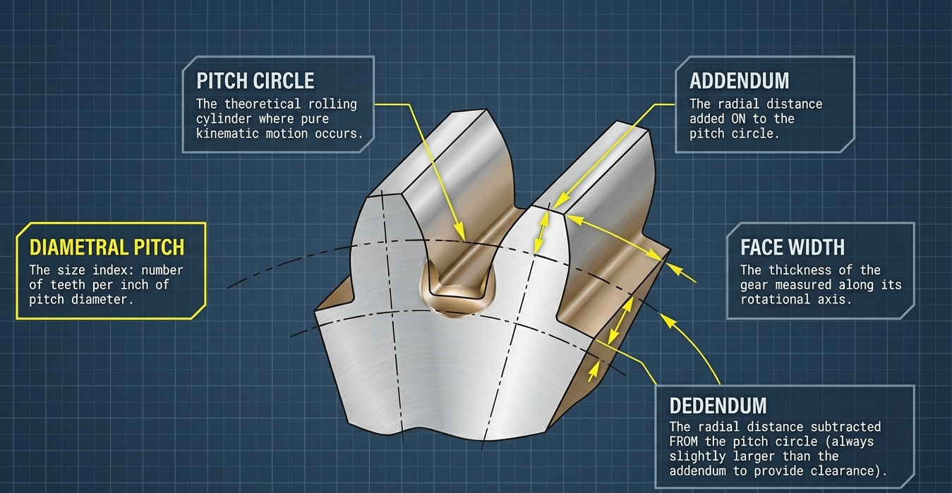
3. Gear tooth nomenclature review

Slide 6
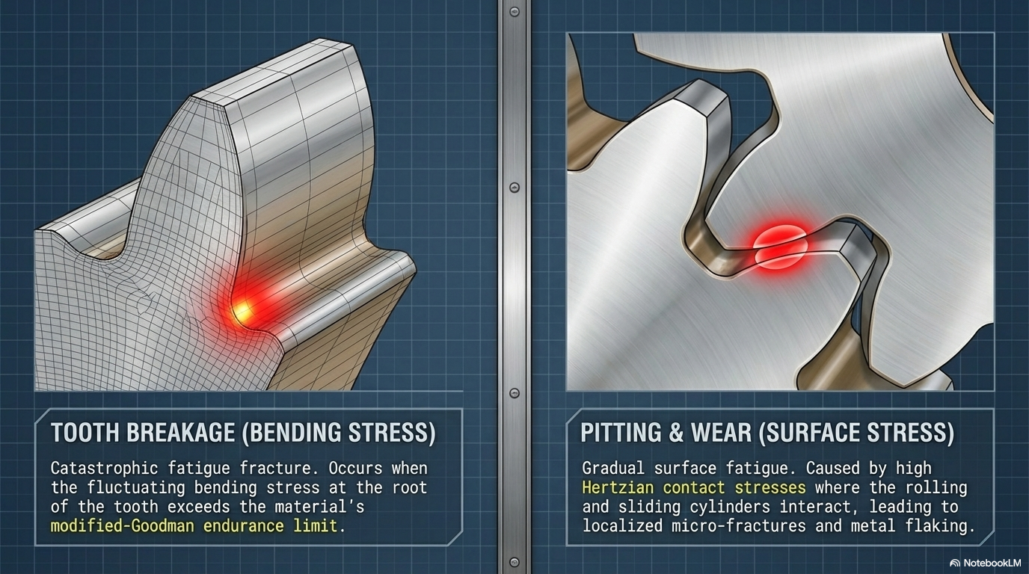
4. Stresses in spur gears (two modes of failure)

Slide 7
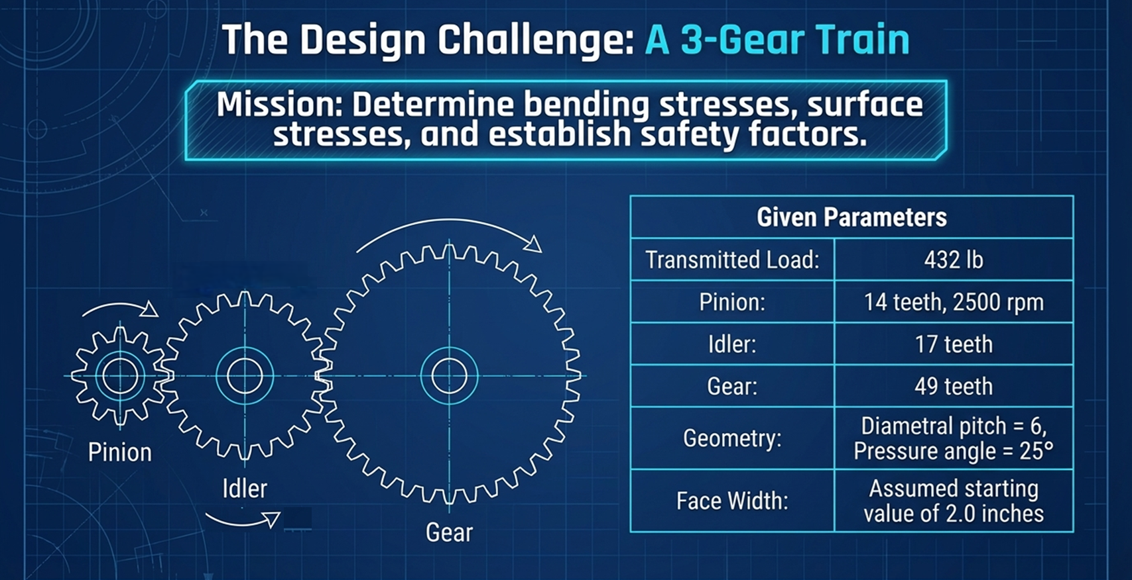
4. Stresses in spur gears (Design)

Slide 8


5. Bending Stresses
THE LEWIS EQUATION: the tooth is a cantilever beam with its critical section at the root. From the bending stress equation in a cantilever beam, he derived in 1892 the following equation:
THE BENDING STRESS EQUATION: valid only for certain assumptions about tooth and gear-mesh geometry (e.g., contact ratio between 1 and 2) – motivation for more complex analyses. J and K’s are empirical terms.

Slide 9

5. Bending Stresses
Example 12-5
Bending Stress Analysis of a Spur-Gear Train
This example analyzes a three-gear train (pinion, idler, and gear) with a transmitted load W_{t} = 432 lb.
Initially, estimate the face width:

Slide 10
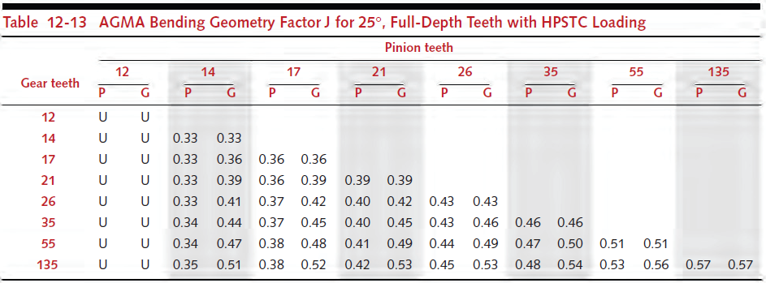
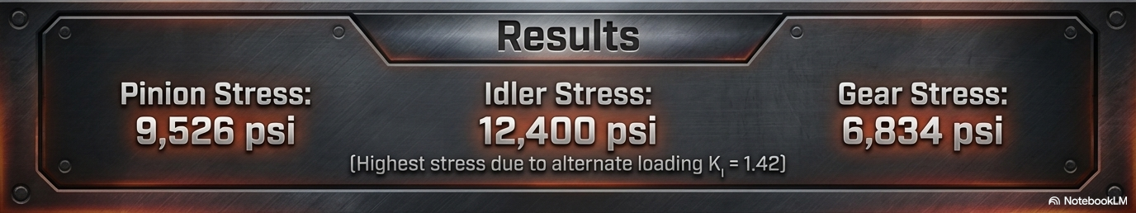
5. Bending Stresses

Slide 11

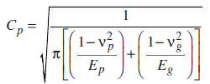
6. Surface Stresses
The stresses at the tooth surface are dynamic Hertzian contact stresses in combined rolling and sliding. Buckingham equation for surface stresses in gear teeth:
Surface geometry factor I in Eq. (12.22) takes into account the radii of curvature of the gear teeth and the pressure angle in empirical formulae.
The surface finish factor C_{f} considers rough surface finishes on teeth – usually 1.
The elastic coefficient C_{p} (psi^{0.5} or MPa^{0.5}) considers different tooth materials:

Slide 12
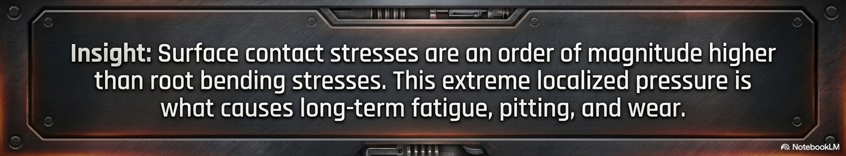
6. Surface Stresses
Example 12-6
Surface Stress Analysis of a Spur-Gear Train
This analysis uses the same gear train to determine the contact (Hertzian) stresses between mating teeth.

Slide 13
7. Gear materials
A limited number of metals and alloys are suitable for gears that transmit significant power (Table 12-18) – Steels, cast irons, and malleable and nodular irons – most common choices for gears.
Bending-fatigue strengths and Surface-fatigue strengths need to be accessed for the analysis. AGMA states for 10⁷ cycles of repeated stress for 99% reliability level. So, correction is needed for other conditions different from AGMA tests.

Slide 14
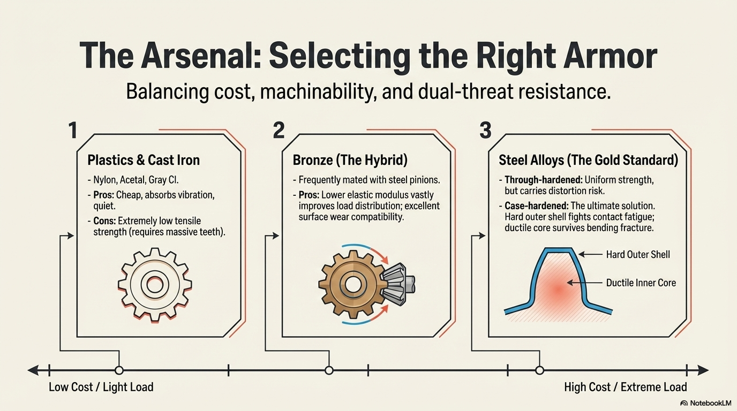
7. Gear materials

Slide 15
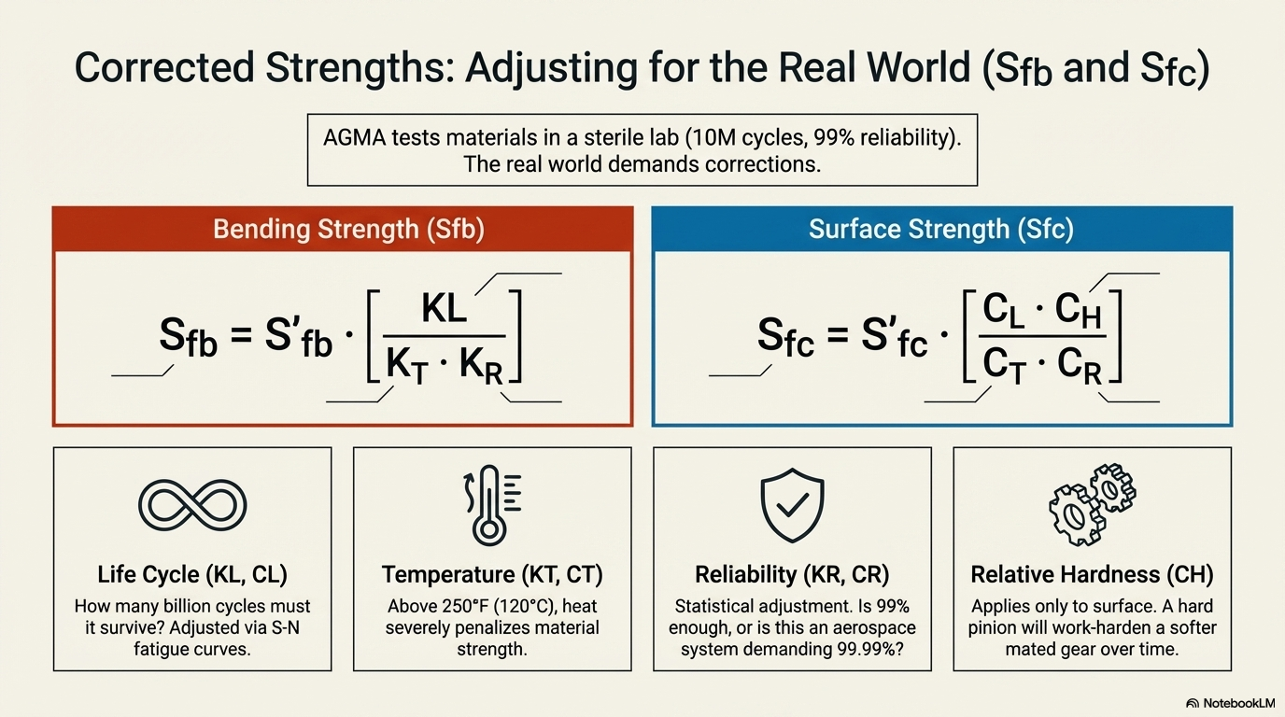
7. Gear materials

Slide 16
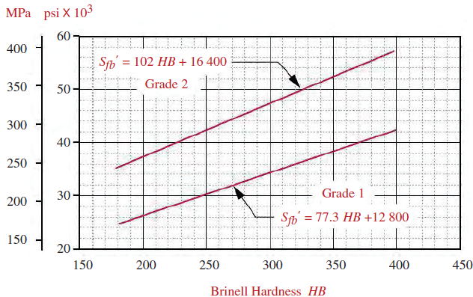
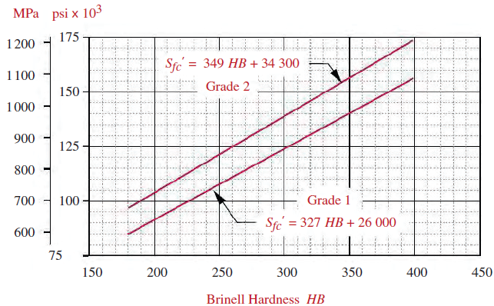
7. Gear materials
AGMA bending-fatigue (steels) and surface-fatigue strengths (through-hardened steels)

Slide 17
7. Gear materials
Example 12-7
Material Selection and Safety Factors for Spur Gears
Select suitable materials and calculate the safety factors for both bending and surface stresses in the 3-gear train.
Service life is 5 years of one-shift operation. All gears are steel. T = 200ºF.
• Initial Selection: Using AGMA Grade 2 steel (through-hardened to 250 HB).
• Corrected Strengths:
o Bending Fatigue Strength (S_{fb}): 38,937 psi.
o Surface Fatigue Strength (S_{fc}): 105,063 psi.

Slide 18

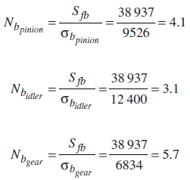
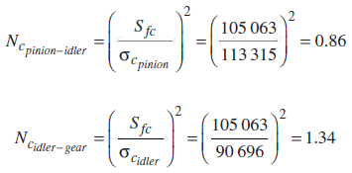
7. Gear materials

Slide 19

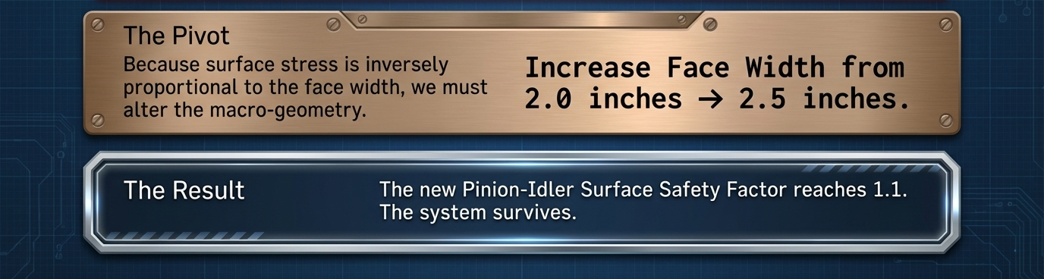
7. Gear materials
Small design change will improve these. Increase face width from 2.0 to 2.5 in (15 / pd) – reduces all stresses and gives new safety factors

Slide 20
8. Summary of the design strategy
• Two Failure Modes: Gears must be checked for both bending fatigue (fracture at the root) and surface fatigue (pitting).
• Catastrophic vs. Gradual: Bending failure is sudden and catastrophic, disabling the machine immediately. Surface failure is gradual, often providing audible or visible warnings before total failure.
• Strategy: Safety factors for bending (N_{b}) should generally be higher than those for surface failure (N_{c}). This ensures that if the gear does fail, it fails via the more "desirable" (non-catastrophic) pitting mode rather than tooth breakage.
• Iteration: adjust face width and materials hardness to meet surface life requirements. Ensure surface failure happens long before a tooth breaks.

Slide 21


8. More complex analyses overview
Thermal and structural analysis of spur gears with the Finite Element Method (FEM)

Slide 22




Acknowledgements
Thank you!
CONTACT
Dr. José V. C. Vargas
vargasjvcv3@gmail.com
http://servidor.demec.ufpr.br/laboratorios/lft/gect/
@Jose Viriato Coelho Vargas
https://www.adscientificindex.com/subject-rankings/?q=jose+viriato+coelho+vargas

Slide 23
References
Robert L. Norton, Machine Design: An Integrated Approach, 6th edition, Pearson, 2020, ISBN: 9780135184233
Richard Budynas and Keith Nisbett, Shigley's Mechanical Engineering Design, 11th edition, McGraw Hill, 2019, ISBN: 9780073398211

